Slide 1
PEECT413 MACHINE LEARNING

Slide 2
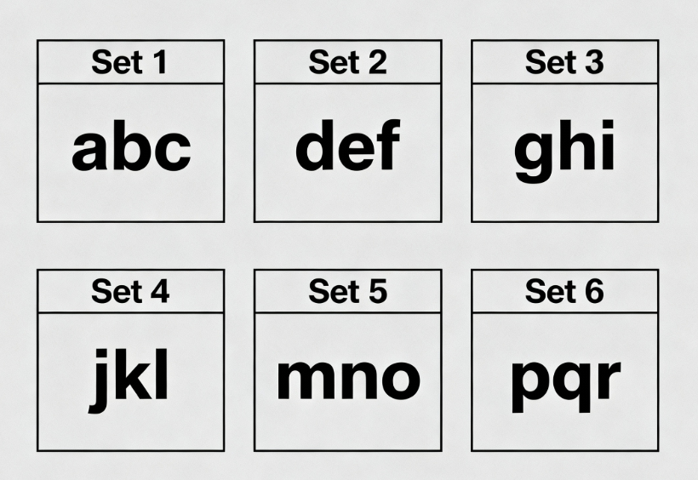
TASK1
Identify the set number of “mno”
Set 5

Slide 3
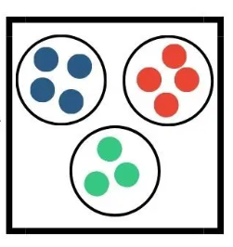
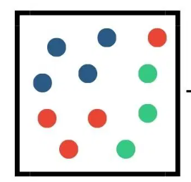
TASK2
Group the given dots and find the number of dots in each colour

Slide 4
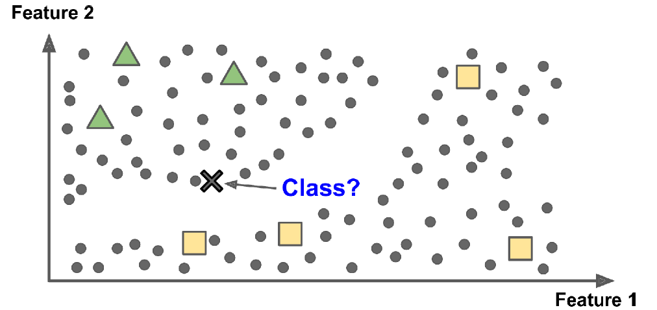
Task 3
Identify the Class of “X” from the diagram
= Triangle

Slide 5
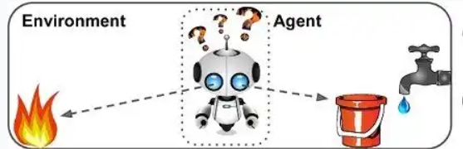
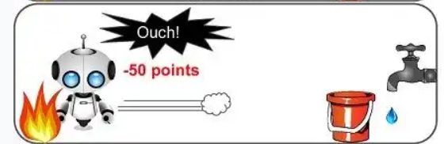
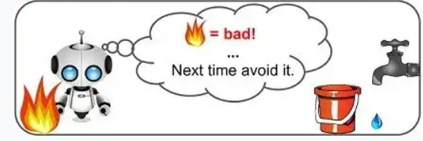
Task 4

Slide 6
Module 1
Review: supervised, unsupervised machine learning techniques,
Dimensionality reduction techniques-PCA, SVD
Instance-Based vs Model-Based Learning, Machine Learning models,
Hyper parameters, regularization,
Training - Batch and Online Learning,
Challenges of Machine Learning: Data Issues-Quality, Relevancy, Over
fitting, under fitting.
Bias, variance,
Performance metrics: Accuracy Recall, Precision, ROC curve

Slide 7
Module 2
Regression: linear regression, logistic regression
Error functions in regression, MSE, L1, L2
Cross entropy multivariate regression.
Classification: Naive Bayes classifier, Support Vector machines, Decision trees -random forests,
Ensemble methods: boosting, bagging.

Slide 8
Module 3
Unsupervised learning: Clustering-K-means, High, Hierarchical clustering,
Criterion functions for clustering, proximity measures, Euclidean, Manhattan, Minkowski Distances, Cosine Similarity.
Reinforcement Learning:
Agent based learning,
Q-learning,
Introduction to HMM (Hidden Markov Model)models

Slide 9
Module 4
Introduction to Artificial Neural Networks: Biological Neuron, Perceptron, Training, limitations, XOR problem,
Multilayer perceptron,
Gradient based learning, stochastic gradient descent,
Activation Functions-Sigmoid, ReLU, tanh.
Back propagation- Chain rule, Regularization- L1, L2,

Slide 10
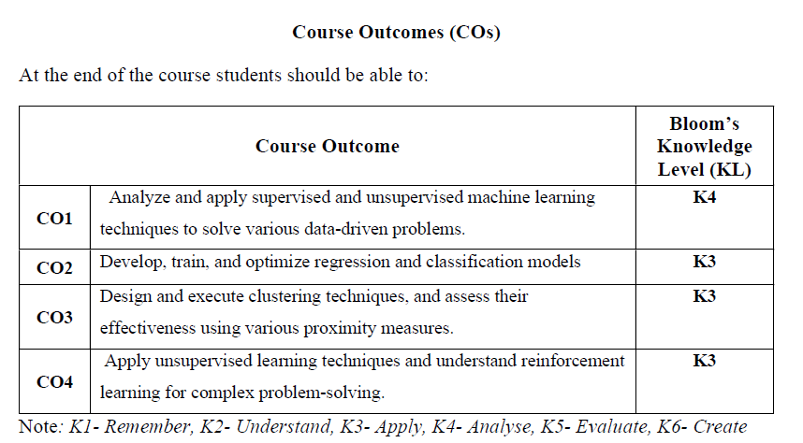

Slide 11
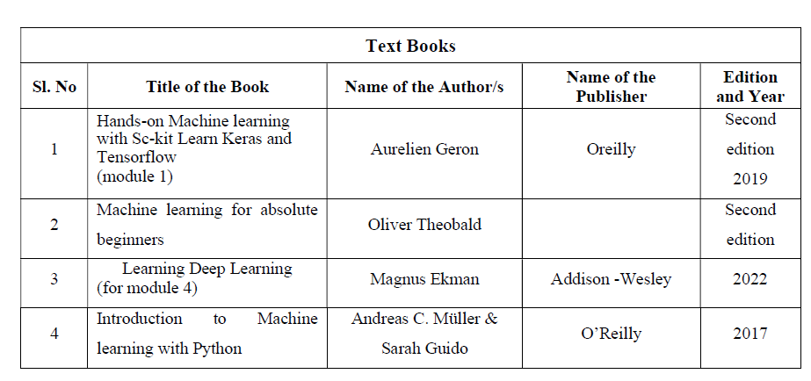

Slide 12
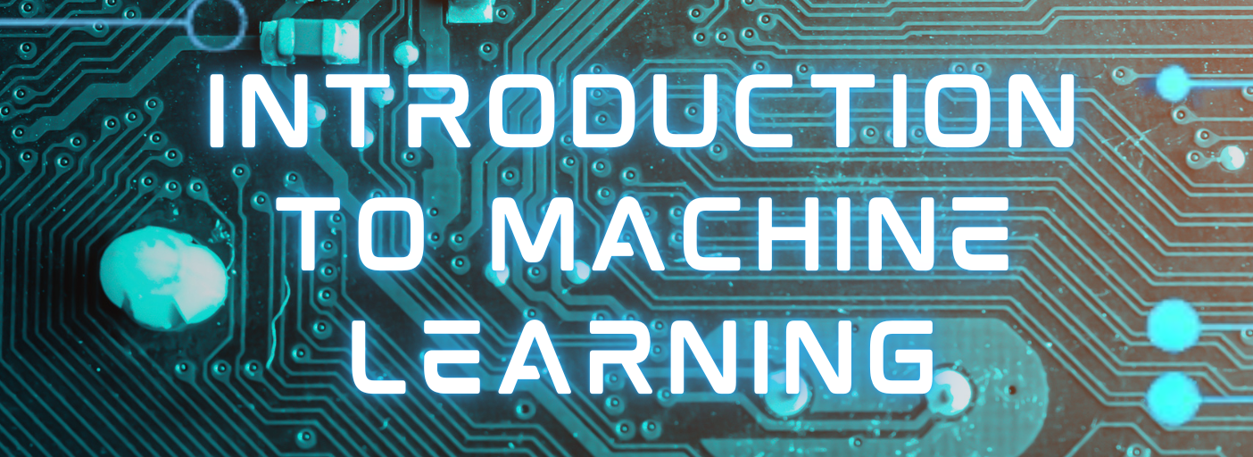

Slide 13
What Is Machine Learning?
Machine Learning is the science (and art) of programming computers so they can learn from data.
There are so many different types of Machine Learning systems that it is useful to classify them in broad categories

Slide 14
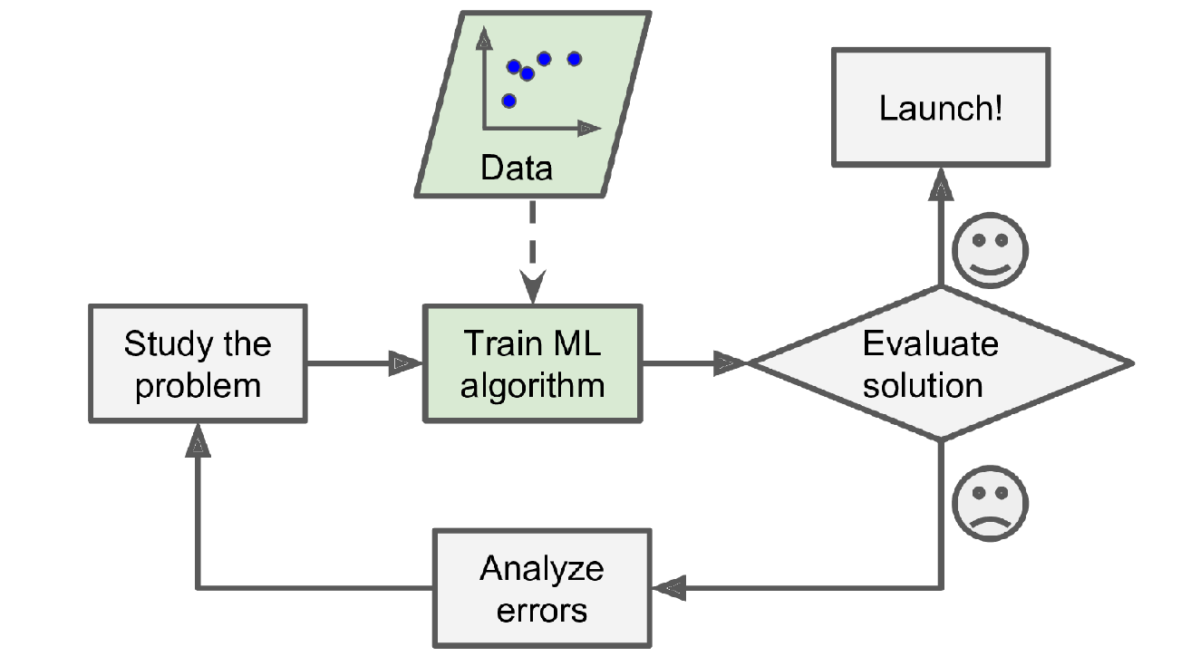
Typical workflow of a machine learning project as a loop
Study the problem: Understand the task, data sources, and what you want to predict.
Use that understanding to collect and prepare “Data”, which is then fed into “Train ML algorithm” to build/train a model.
After training, “Evaluate solution”: if performance is good, “Launch!” the model into production.
If performance is poor, you go to “Analyze errors” to see where the model fails, then loop back to “Study the problem” to refine data, features, or algorithm and repeat the cycle.

Slide 15
Types of Machine Learning Systems
Supervised, unsupervised, semi-supervised, and Reinforcement Learning
Whether or not they are trained with human supervision
Online versus batch learning
Whether or not they can learn incrementally on the fly
Instance-based versus model-based learning
Whether they work by simply comparing new data points to known data points, or instead by detecting patterns in the training data and building a predictive model, much like scientists do
Hybrid models

Slide 16
Supervised/Unsupervised Learning
Machine Learning systems can be classified according to the amount and type of supervision they get during training. There are four major categories:
Supervised learning
Unsupervised learning
Semisupervised learning
Reinforcement Learning

Slide 17
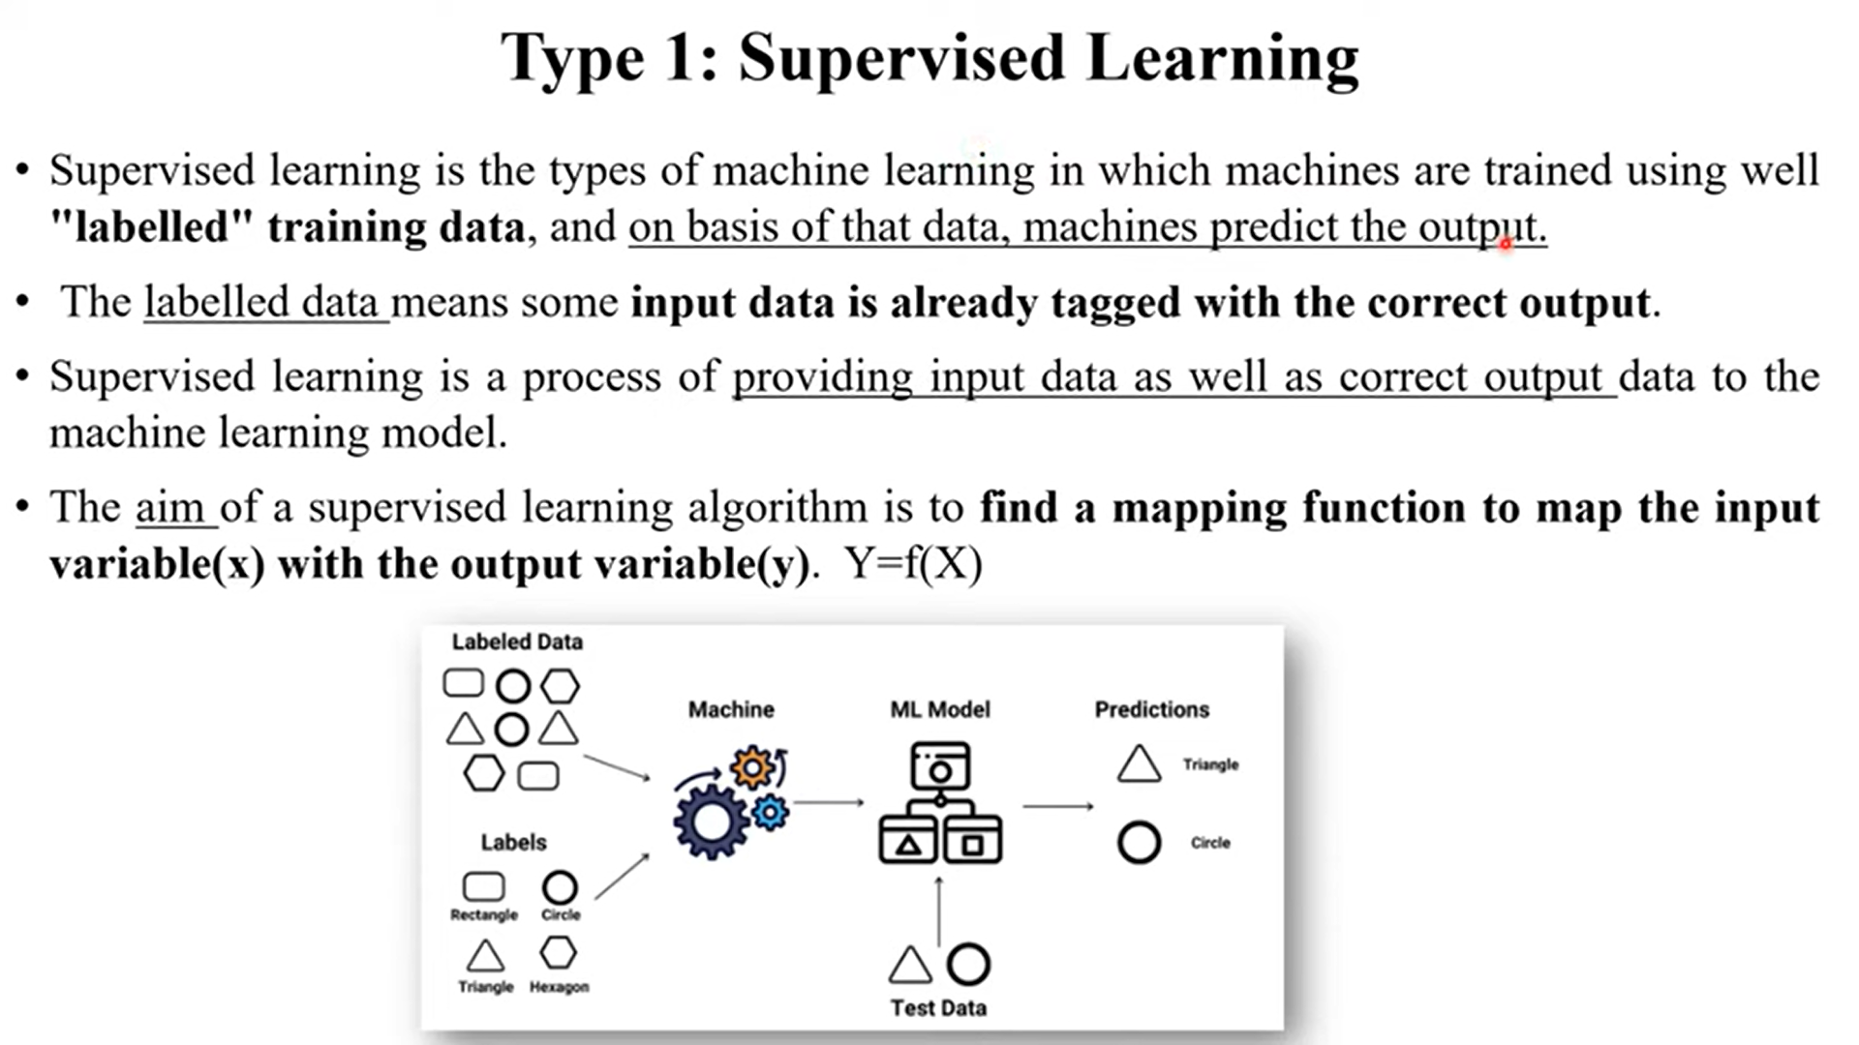

Slide 18
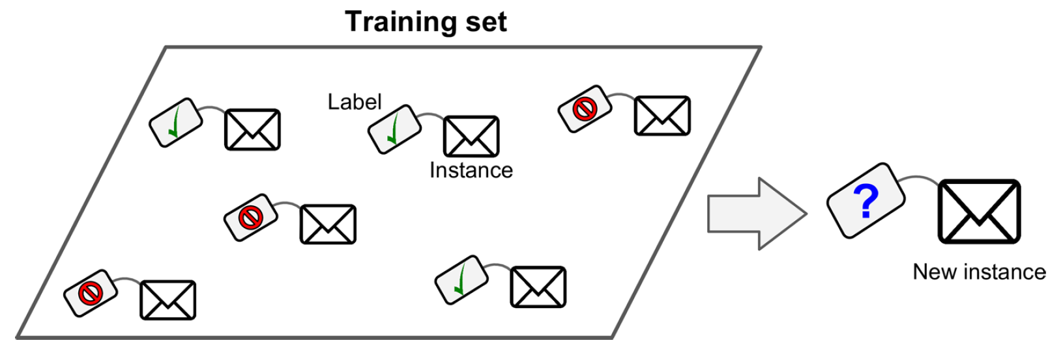
Supervised learning
The training set you feed to the algorithm includes the desired solutions, called labels
A typical supervised learning task is classification. The spam filter is a good example of this: it is trained with many example emails along with their class (spam or ham), and it must learn how to classify new emails.

Slide 19
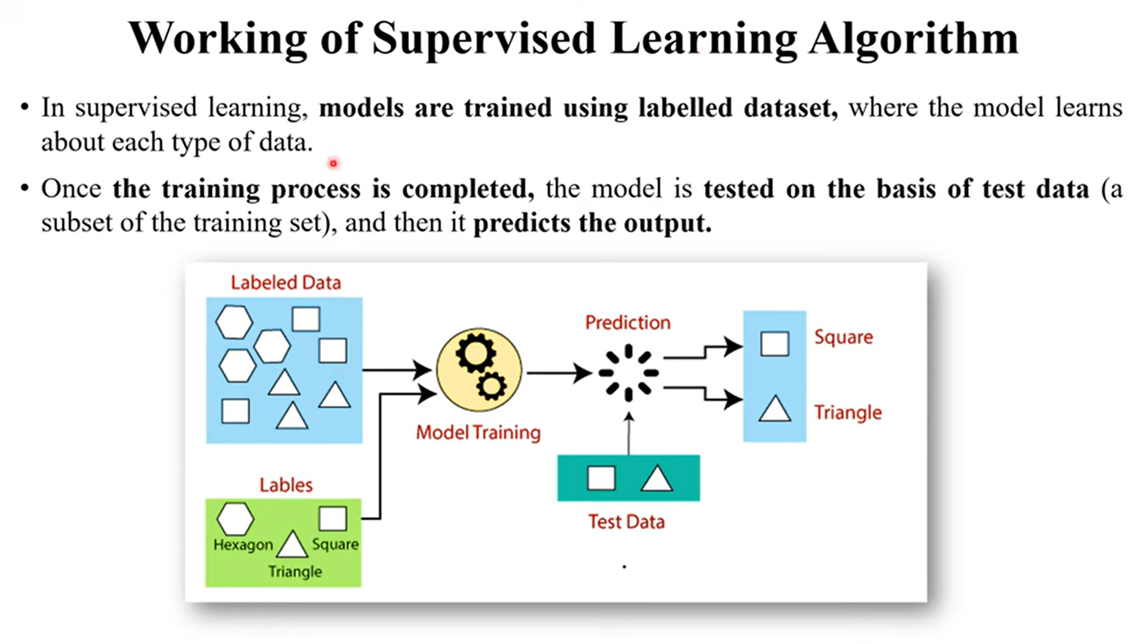

Slide 20
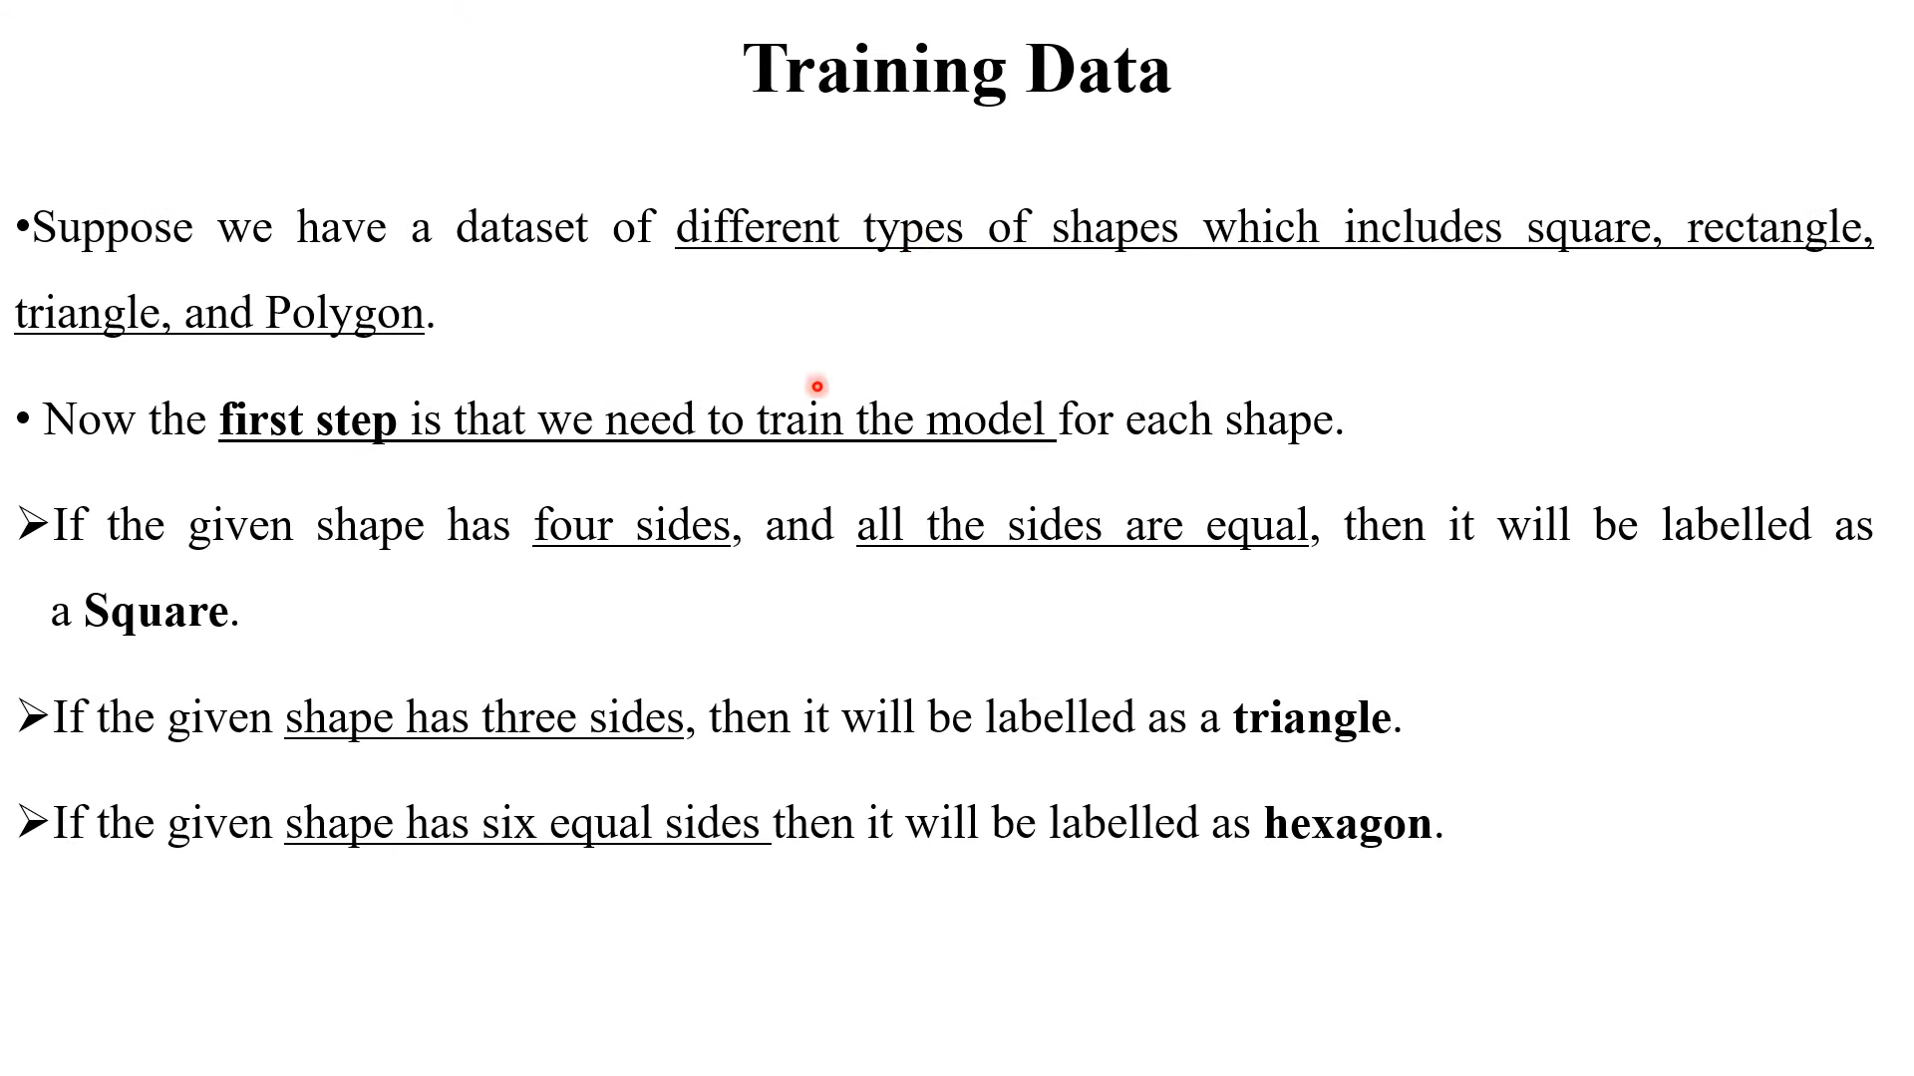

Slide 21
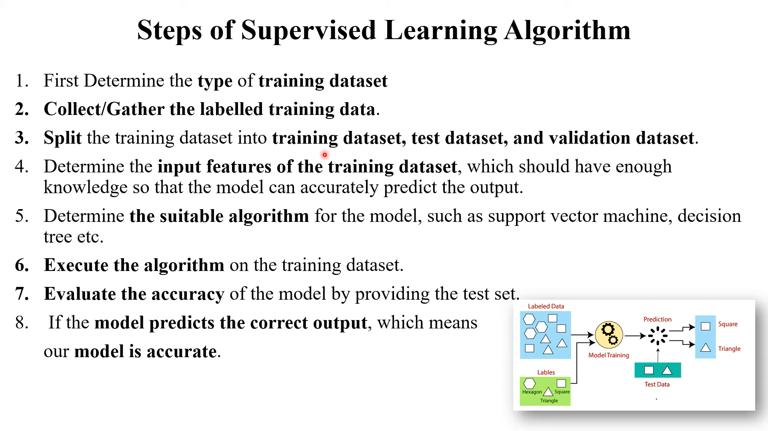

Slide 22
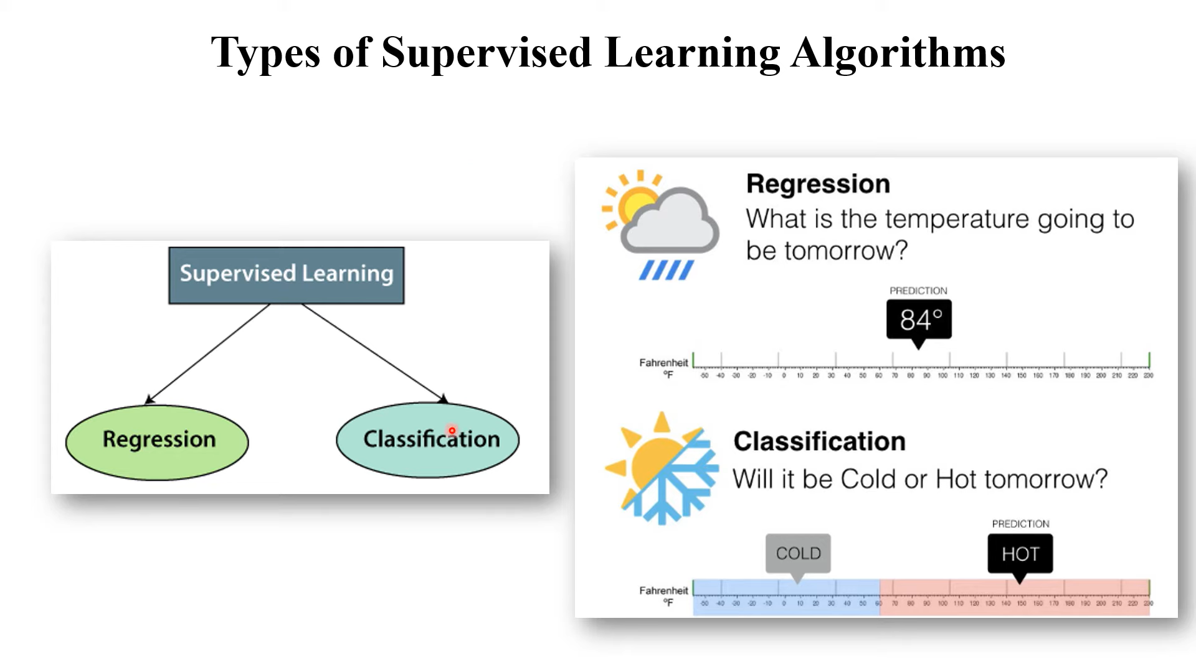

Slide 23
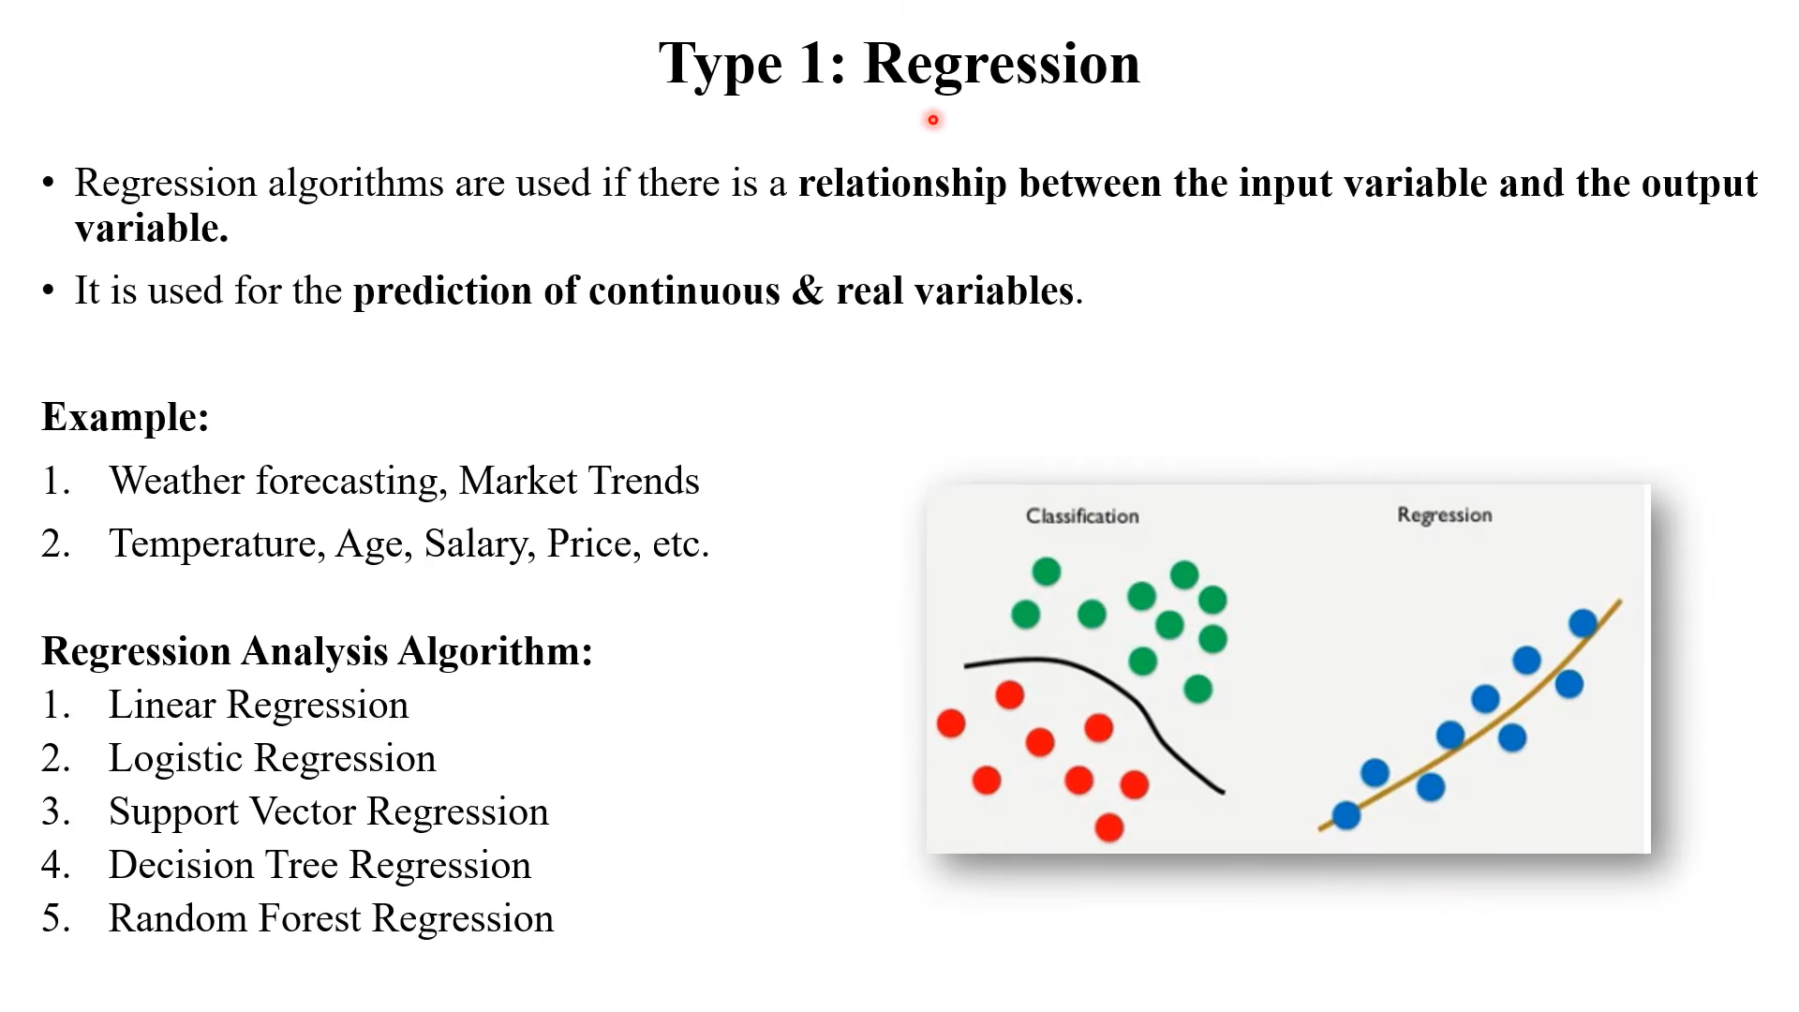

Slide 24
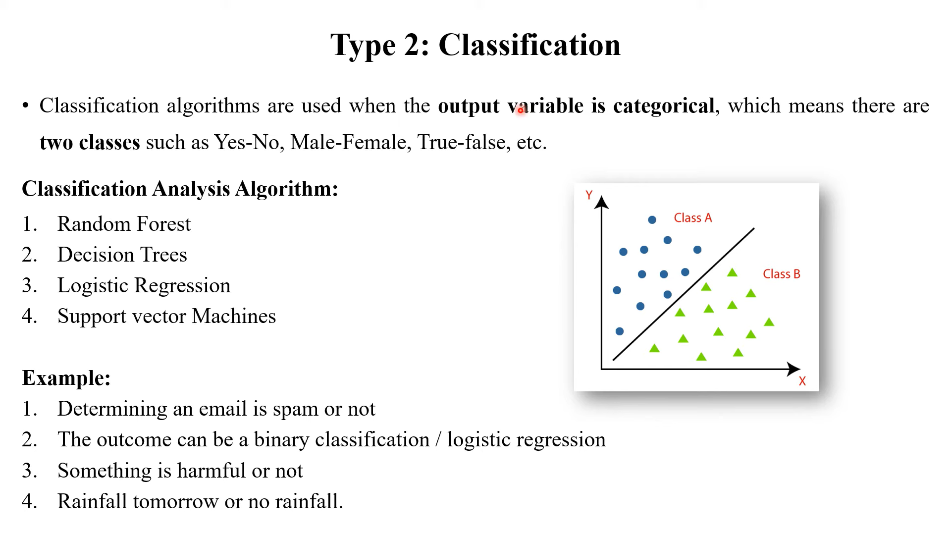

Slide 25
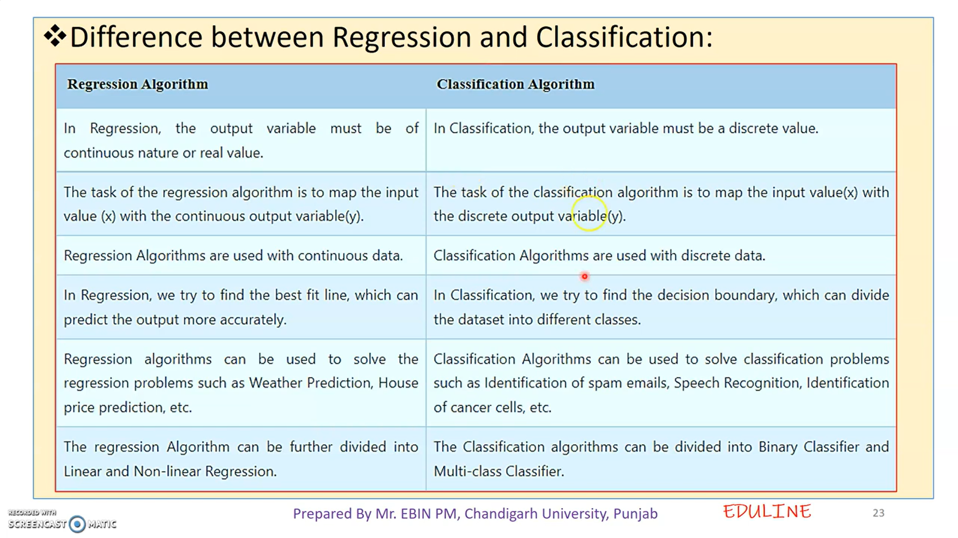

Slide 26
Supervised learning
Some of the most important supervised learning algorithms
k-Nearest Neighbors
Linear Regression
Logistic Regression
Support Vector Machines (SVMs)
Decision Trees and Random Forests
Neural networks

Slide 27
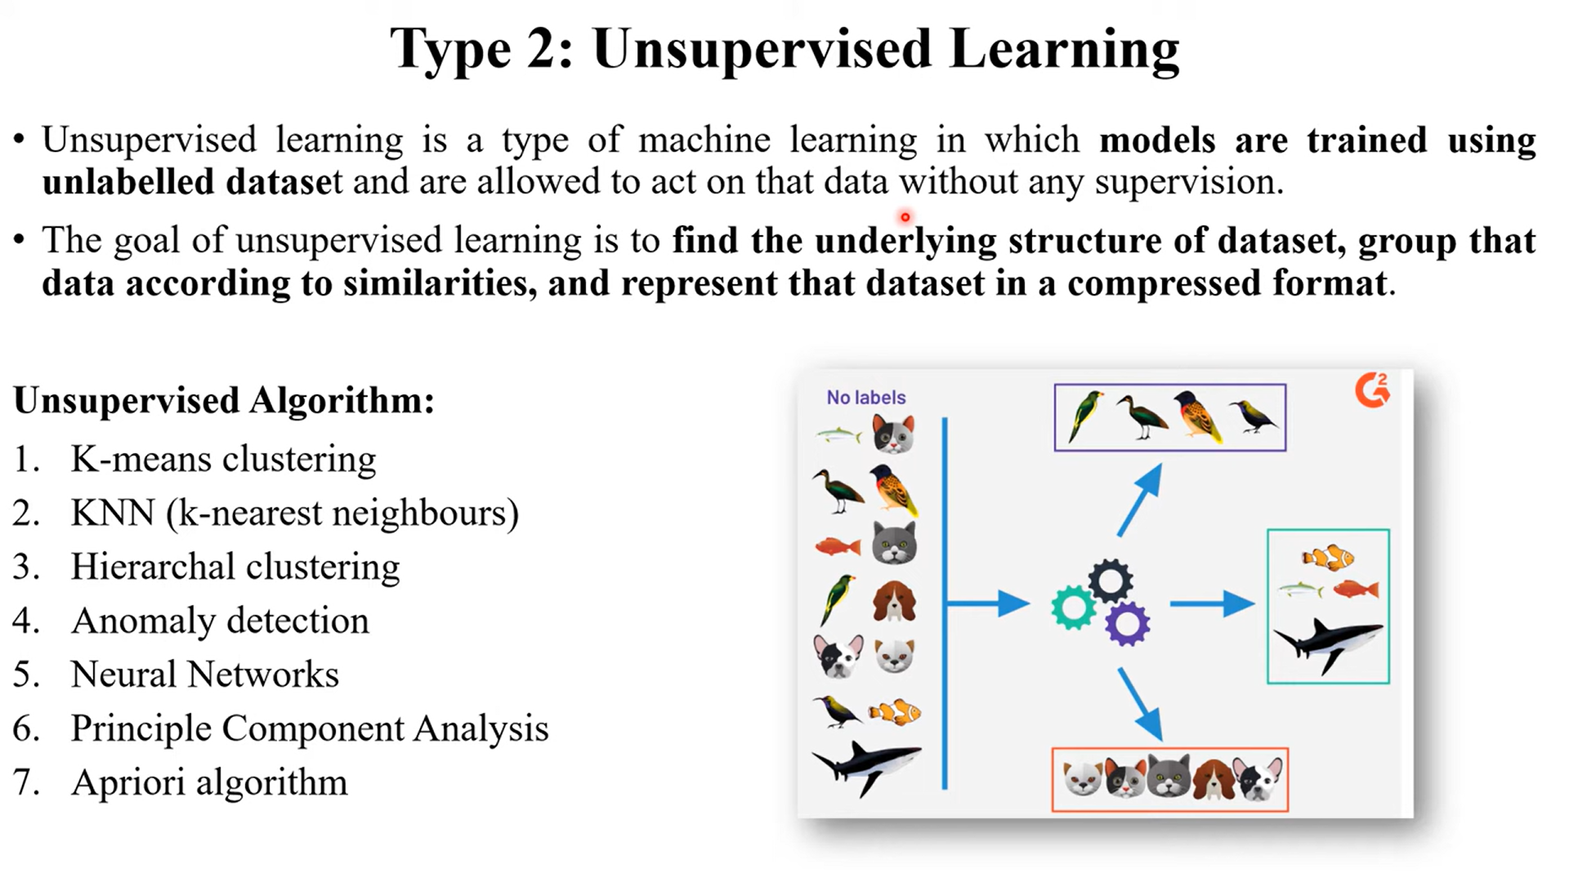

Slide 28
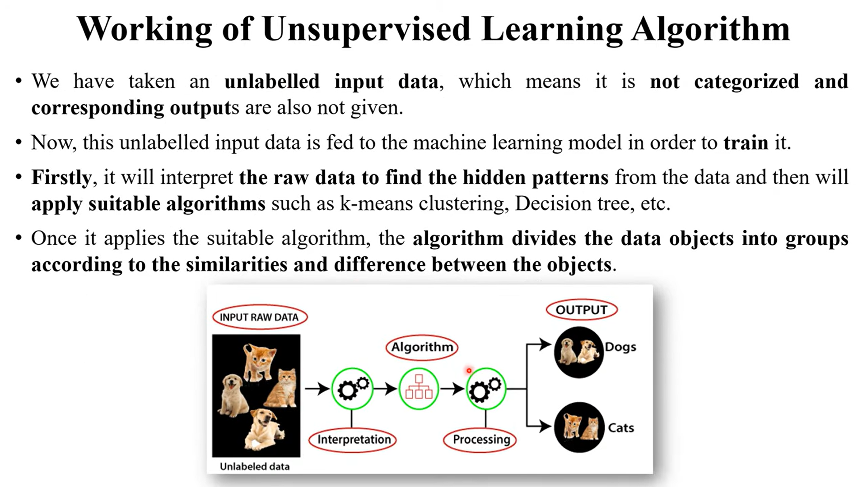

Slide 29
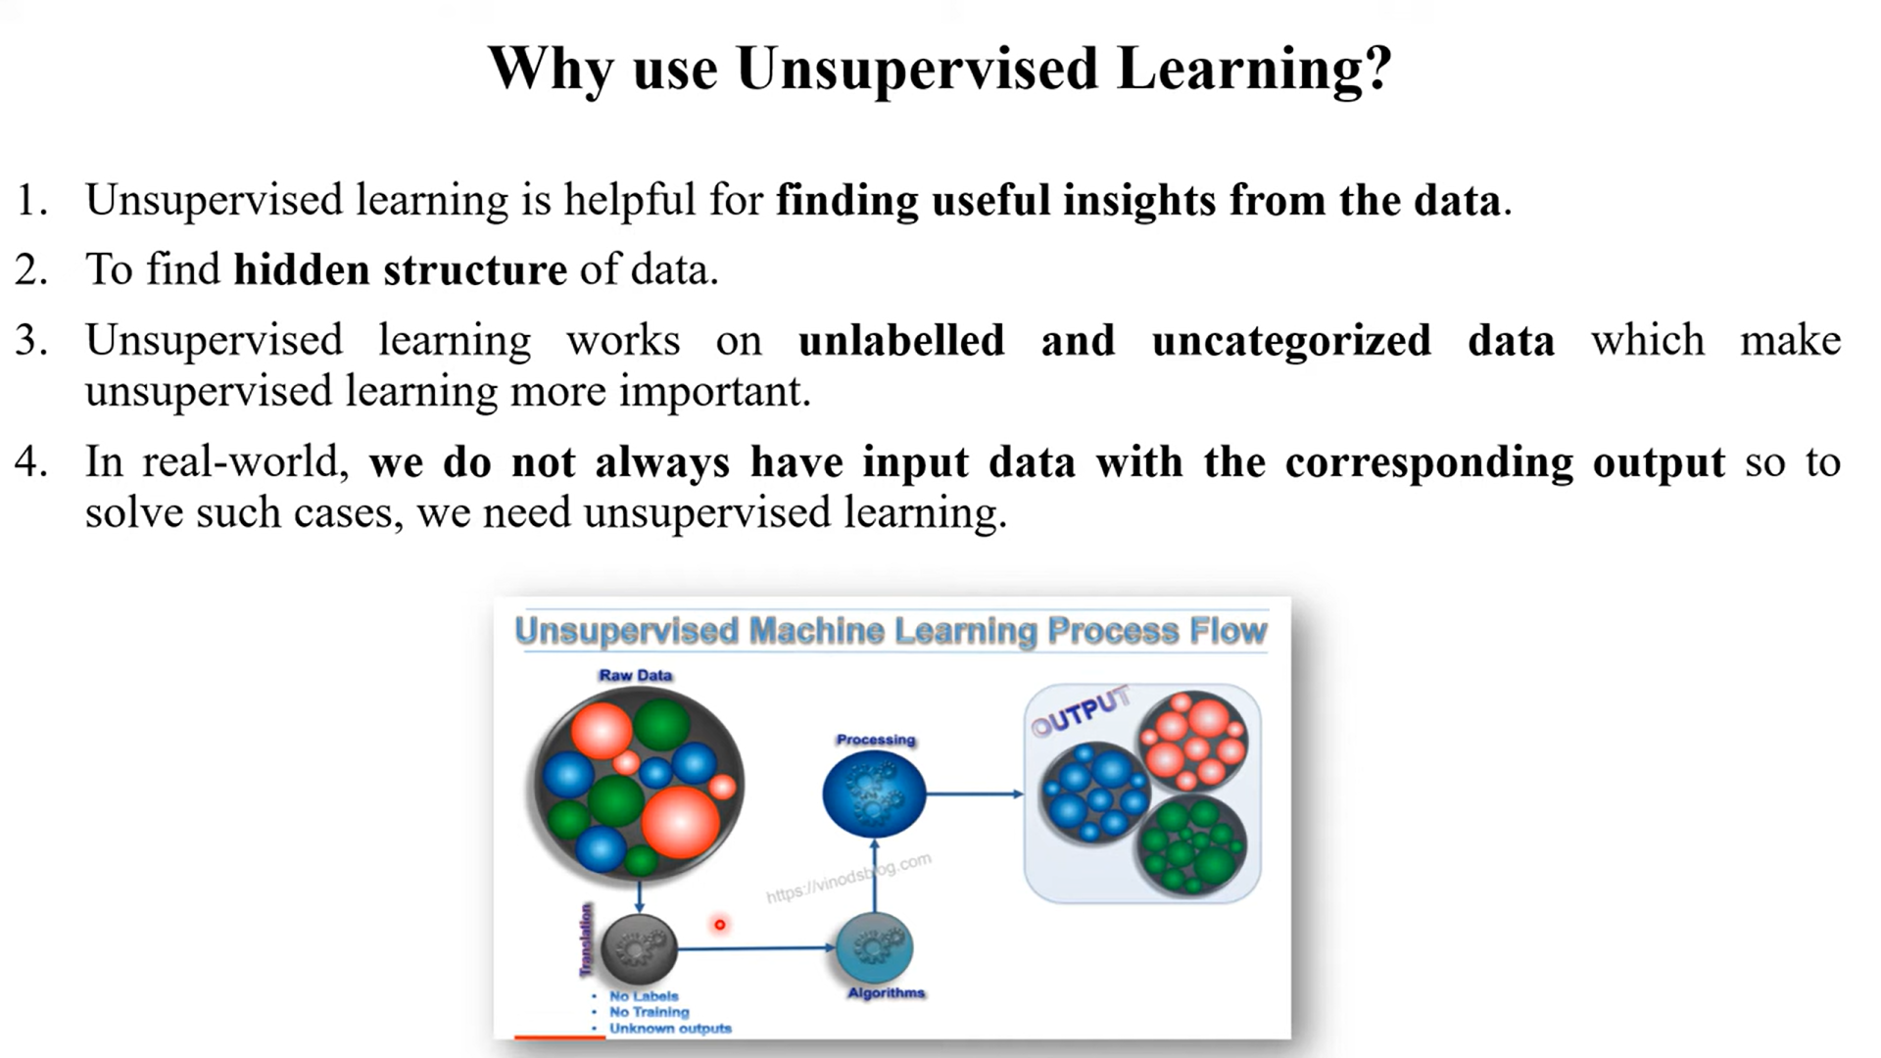

Slide 30
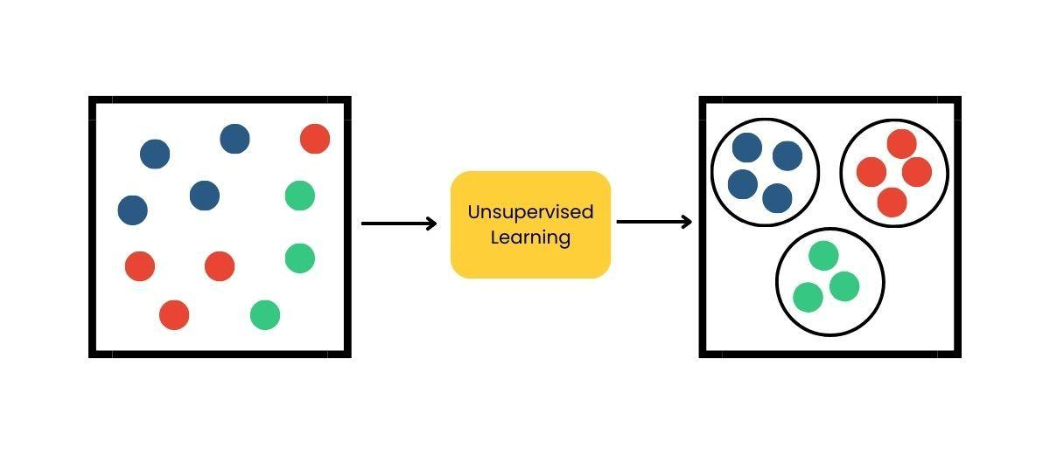
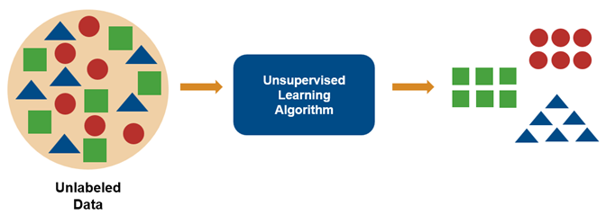
Unsupervised learning

Slide 31
Unsupervised learning
The system tries to learn without a teacher or label.
Some of the most important unsupervised learning algorithms
Clustering
K-Means, DBSCAN, Hierarchical Cluster Analysis (HCA)
Anomaly detection and novelty detection
One-class SVM, Isolation Forest,
Visualization and dimensionality reduction
Principal Component Analysis (PCA), Kernel PCA, Locally Linear Embedding (LLE), t-Distributed Stochastic Neighbor Embedding (t-SNE)
Association rule learning
Apriori, Eclat

Slide 32
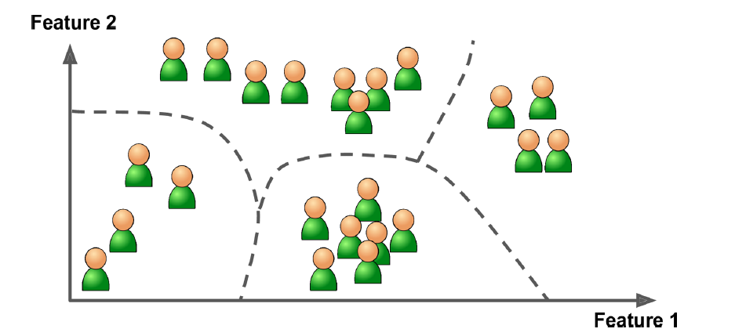
Unsupervised learning - Clustering

Slide 33
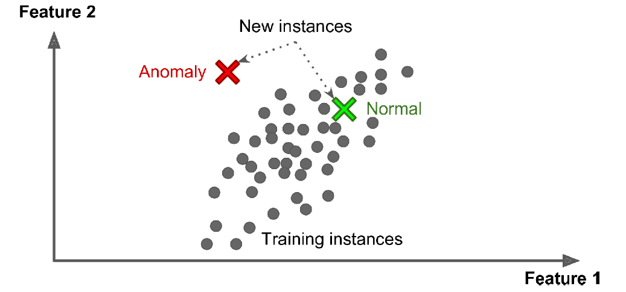
Unsupervised learning - Anomaly detection

Slide 34
Semisupervised learning
Learning algorithm that works with unlabeled instances and a few labelled instances.
Eg: Google Photos
Semisupervised learning with two classes (triangles and squares): the unlabeled examples (circles) help classify a new instance (the cross) into the triangle class rather than the square class, even though it is closer to the labeled squares

Slide 35
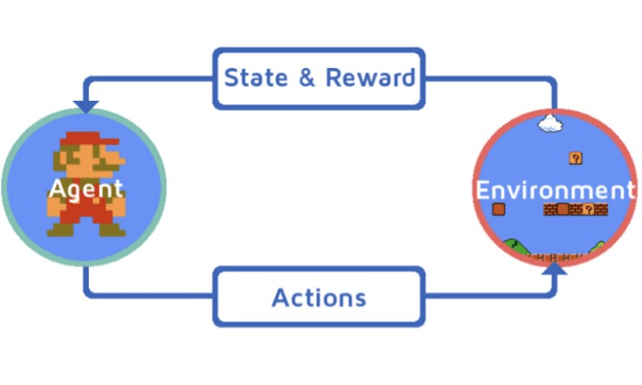
Reinforcement Learning

Slide 36
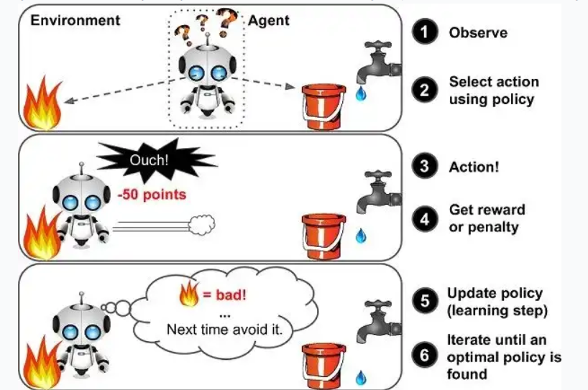
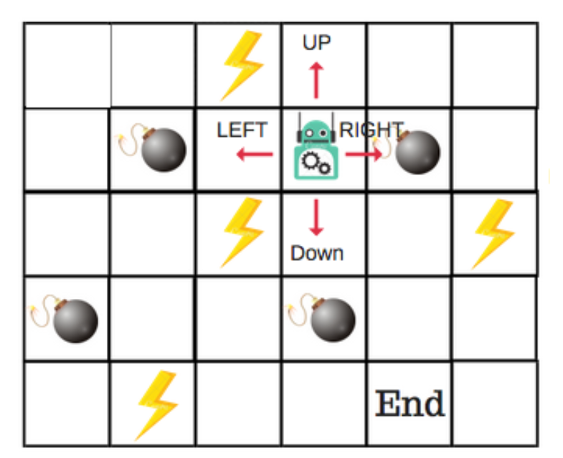
Reinforcement Learning

Slide 37
Reinforcement Learning
The learning system, known as an agent, can observe its environment, choose and perform actions, and receive rewards or penalties (negative rewards) in response.
Self-learning occurs as the agent develops a strategy to maximise its rewards over time.
A policy outlines the action the agent should take when faced with a specific situation.
For example, many robots implement Reinforcement Learning algorithms to learn how to walk.

Slide 38
Aspect | Supervised Learning | Unsupervised Learning | Semi-Supervised Learning | Reinforcement Learning
Data Type | Labeled (input + output) | Unlabeled (input only) | Mix: small labeled + large unlabeled | No predefined data; environment interactions
Supervision | External (labels guide learning) | None (self-discovers patterns) | Partial (labels + unsupervised structure) | None; reward/penalty feedback
Main Tasks | Classification, regression | Clustering, association, dimensionality reduction | Improves predictions with limited labels | Sequential decision-making
Common Algorithms | SVM, Decision Trees, Neural Networks | K-Means, PCA, Autoencoders | Self-training, Co-training | Q-Learning, DQN, SARSA
Goal | Predict outcomes accurately | Discover hidden patterns | Enhance accuracy cost-effectively | Maximize cumulative rewards
Applications | Spam detection, medical diagnosis | Customer segmentation, anomaly detection | Speech analysis, image recognition | Robotics, gaming, self-driving cars
Challenges | Needs lots of labeled data | Interpretability, lower accuracy | Complex process, still less accurate | Reward design, sample efficiency

